Slide 1
An effective solution for color blind people using color detection model

Slide 2
Team Details
Faculty Mentor
Dr Hitesh Kumar Sharma
Members
Adesh Kumar Gupta
Shankey Gupta
Tushar Singh
Utkarsh Sandeep Singh

Slide 3
Problem Statement
Nowadays most of the people can be seen as a victim of Color Blindness which is an incurable disease because of genetic disorder. It can be cured by some genetic therapy but it is very much costly. The problem they face is that these people are unable to differentiate between shades of color or when two colors are mixed together so it will be very difficult for them to see item’s color clearly. So, the problem is how it can be analyzed without curing the disease.

Slide 4
Description
Now in order to implement the setup and develop the model which would help as an aid for the color blind people, some techniques and methods needs to be put in use which include libraries like NumPy, OpenCV and a technique called Image Processing.
OpenCV(Open Source Computer Vision) library aims at real time Computer Vision. It is mainly used to do all the operations related to images.
NumPy is Python Package which stands for Numerical Python. This library consists of multidimensional array objects and a collection of routines for processing of array.
Image Processing technique is used to perform some certain operations on an image, in order to get an enhanced image as an output or to extract some useful information from the image. It acts as a type signal processing in which input is an image and output may be an image or characteristics/features associated with that image.

Slide 5
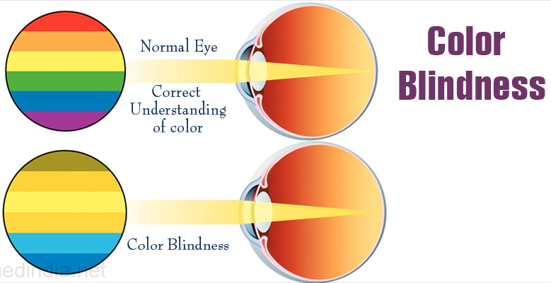
An Example
The image shown here clearly depicts an example of how a color blind eye is different from a normal eye and how difficult it is for these people who suffer with this deficiency to properly visualize a specific color sometimes.
These people may find their views and their observations on how an object looks like to them a lot different then how other people see it.
A color detection model should prove helpful and beneficial for them so that they don’t get pushed back among other people in today’s generation and should get all the opportunities that they deserve but can’t achieve due to their problem which restricts them.

Slide 6
Objectives
To identify the color of the given object kept in front of the camera.
To represent the color found on the object and generating its respective RGB color code.

Slide 7
Methodology
Theory:
Color detection model is used to find the respective color, and its’ shade. Color detection model will be useful for people having disorder of color blindness, agricultural fields and in medical fields as well.
For the implementation of this technique, we need to have some python libraries:
OpenCV
To use camera and to identify object’s color from that camera in our code.
NumPy
To store the range of the color on the screen, i.e. to identify the location of the colors present on the screen.

Slide 8
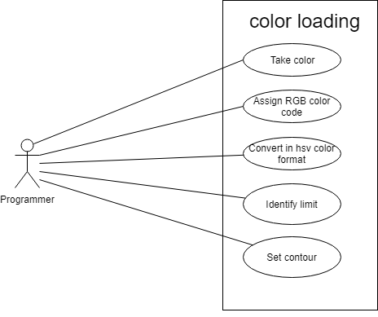
Use Case
Color Loading

Slide 9
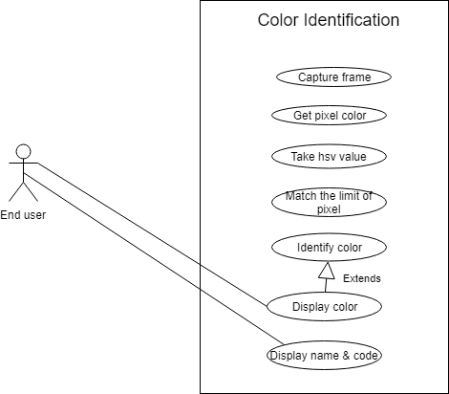
Color Identification

Slide 10
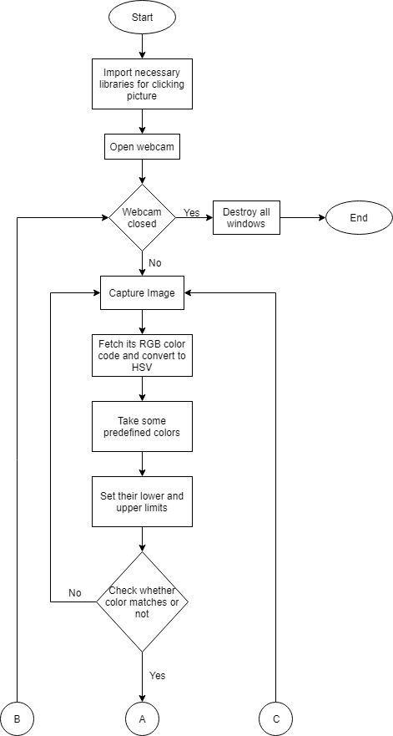
Flow Chart

Slide 11
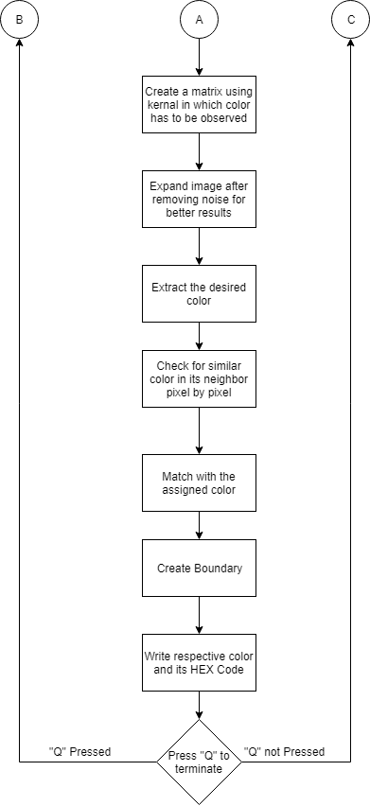

Slide 12
Algorithm:
Importing Modules
Capture livestream video through webcam
Converting image frame from BGR(Blue-Green-Red) to HSV(Hue-Saturation-Value)
Defining the range of each color in the image.
Find range of the colors in the frame
Track the color and draw a rectangle around it
Display output as a video stream in a window with the colors being tracked displaying their names and color codes as soon as it tracks an object.

Slide 13
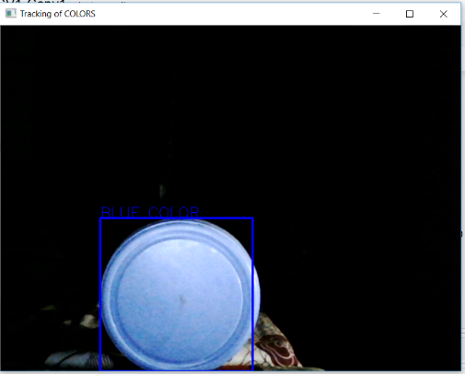
Output Screen

Slide 14
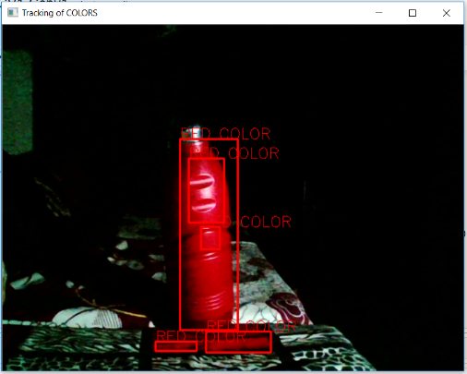

Slide 15
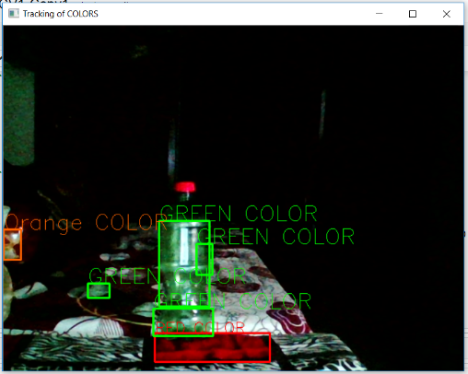

Slide 16
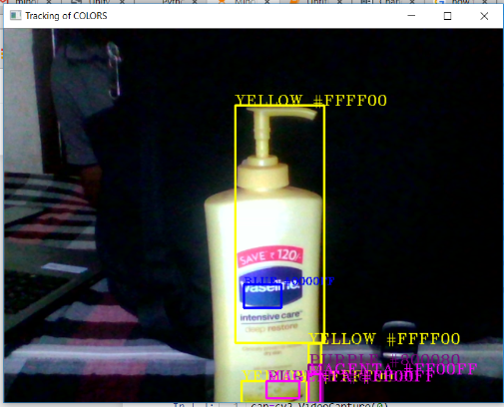

Slide 17
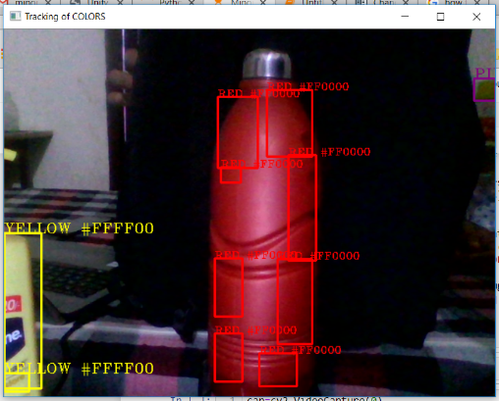

Slide 18
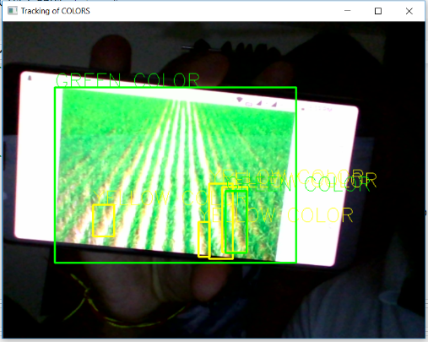
Proposed Application
Identification of weeds in crops

Slide 19
Schedule(Pert Chart)

Slide 20
References
Documented Reference:
[1] An image processing technique for color detection and distinguish patterns with similar color: An aid for color blind people
https://www.researchgate.net/publication/282270361
[2] Methods and Means for Color Detection and Modification
https://patents.google.com/patent/US4488245A/en
[3] Method for color detection in video images https://patents.google.com/patent/US6574363B1/en
[4] Study on Object Detection using Open CV – Python
International Journal of Computer Applications (0975 – 8887) Volume 162 – No 8, March 2017

Slide 21
THANK YOU!

